Slide 1
Livability
Things to consider when choosing a place to retire

Slide 2
Temperature

Slide 3
Air quality

Slide 4
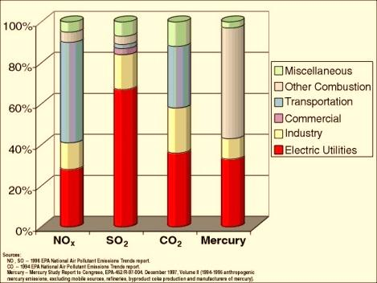
Bad air culprits

